Slide 1

Acute Cervical Injuries In Football
Mark A. Giovanini MD
NeuroMicroSpine Specialist
Neurospine Institute
Gulf Breeze Florida
Sandestin Executive Health and Wellness Center
Orlando Florida
Park City Utah
www.neuromicrospine.com
www.neurospineinstitute.org

Slide 2
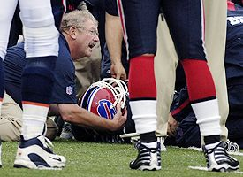
Kevin Everett Spinal Cord Injury

Slide 3
Scope of Cervical Injuries
50% of Sport Injuries are to the C-spine
Football and Rugby have highest frequency
10-15% of football injuries are cervical spine injuries
Most are self limited and do not have permanent neurologic injury.

Slide 4
Types of Neck Injuries
Nerve root or brachial plexus injuries
Acute cervical sprains/strains
Intervertebral disk injuries
Cervical fractures
Cervical stenosis and transient spinal cord injury

Slide 5
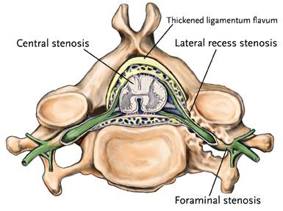
Cervical Anatomy

Slide 6
Mechanism of Injury
Hyper-flexion and Axial loading
Fractures, Herniated Discs and Ligamentous
Cervical Root Injury, Spinal Cord Injury
Hyper-extension Injuries
Ligamentous, Posterior column Fractures
Spinal Cord Injury, Contusions, Central Cord Syndrome

Slide 7
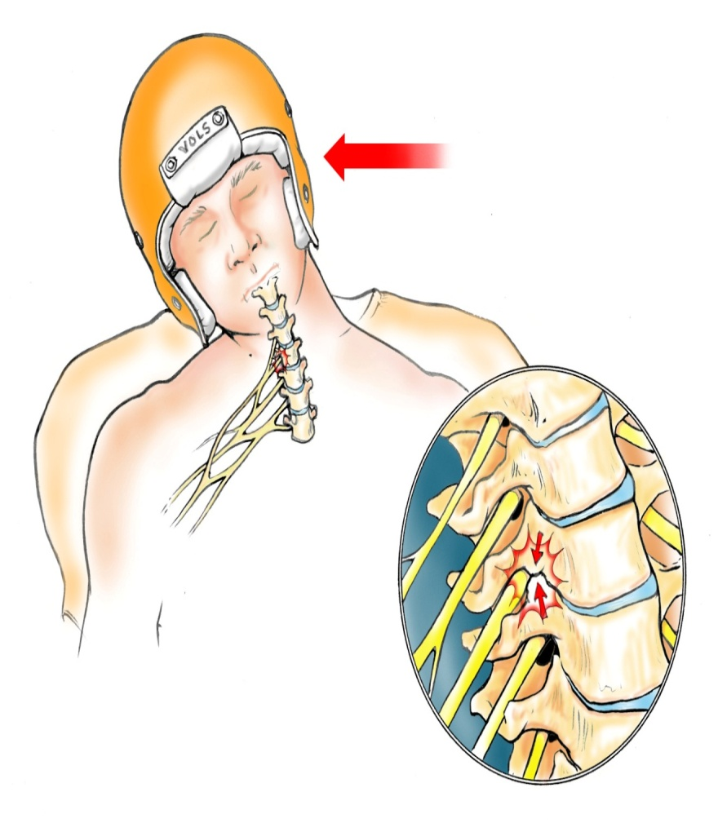
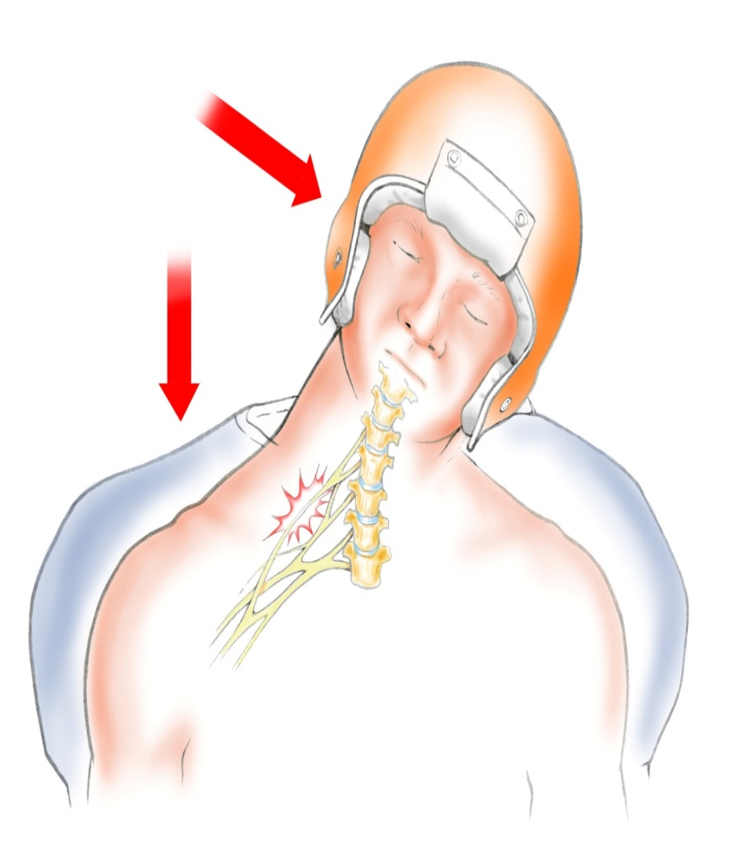
Nerve root/brachial plexus injury
Cervical Root Stinger
Brachial Plexus Stinger

Slide 8
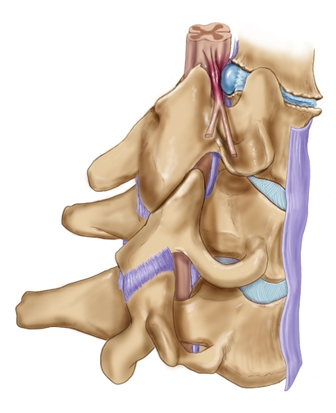

Cervical Root Injury Lateral Compression

Slide 9
Cervical Root vs. Plexus
Pain, paresthesia, weakness or numbness in arm
Lateral compression towards arm
Painful ROM of neck
Work up of neck to RO instability
RTP after eval and sx resolve
Pain, paresthesia, weakness or numbness in arm
Distraction away from arm
Painless ROM of neck
Return to play when sx resolve

Slide 10
Cervical sprain
Most common injury to spine
Axial compression to spine
Pain in paraspinal region in neck
No arm symptoms or neurologic symptoms
Cspine xray with flexion/extension
RTP when symptoms resolve

Slide 11
Cervical Disc Injury
Acute onset of neurologic deficits or pain down one or more extremities.
Ruptured disc with root or cord compression
Root involves one extremity
Cord involves more than one extremity
Persistant symptoms radiographs normal
MRI evaluation for persistant neurologic symptoms

Slide 12
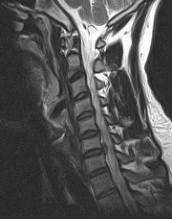
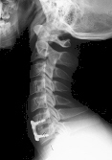
Cervical Disc Herniation Football Injury
21 y/o middle LB Collegiate level
Transient CCN 15 min. all ext.
Residual R C7 radiculopathy
PT, Pain anagement
Surgery
Desires return to football

Slide 13
Cervical disc herniation post operative
Return to play in 8 to 12 weeks
Outpatient operation
Symptoms resolved with normal neurologic exam
No restrictions
Risk of adjacent level trauma unknown

Slide 14
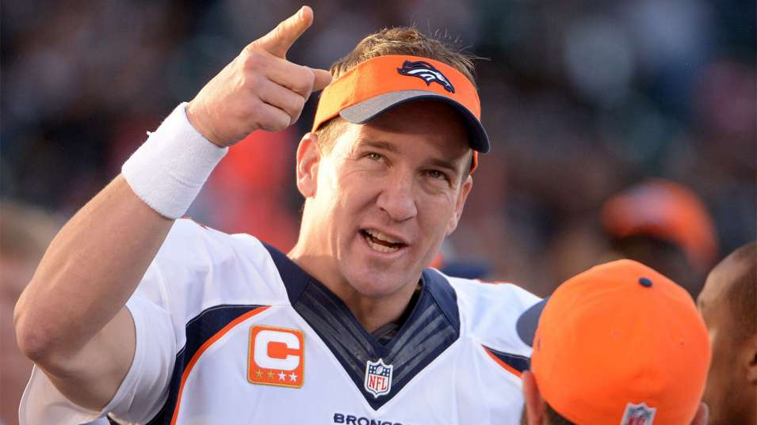

Slide 15
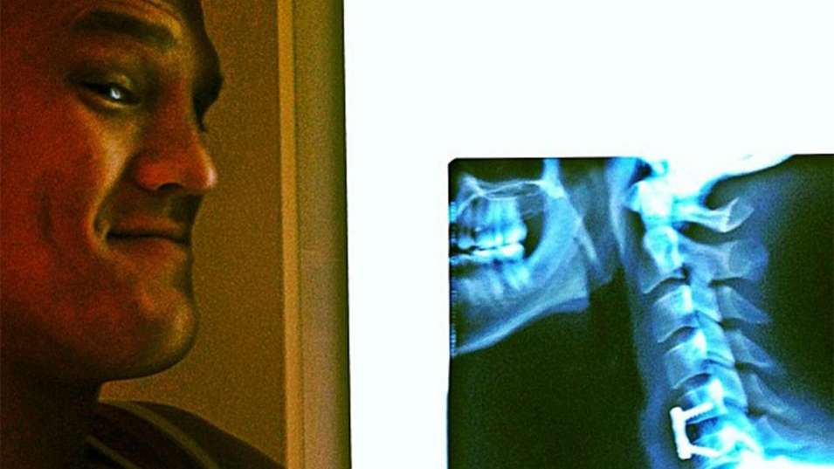

Slide 16
Cervical disc herniation anterior cervical discectomy and fusion
Risk of adjacent level deterioration is 100%
Risk of subsequent clinical injury unknown
Player assumes risk of subsequent injury.

Slide 17
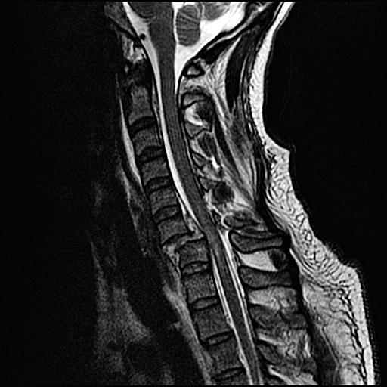
Cervical Fracture
Rare
Hyper-flexion/Axial Loading
Neck Pain
Palpable tenderness
May or may not have SCI
Highly unstable
Needs Immobilization and Transport to tertiary care center
Surgery necessary
RTP is never possible

Slide 18
Syndromes of Spinal Cord Injury
Clinical Syndromes
Clinical effects
Central Cord Syndrome
Brown-Sequard Syndrome
Transient Quadriplegia
Permanent Quadriplegia
Cervical Radiculopathy
Both hands>arms>legs
Unilateral arm/leg
Transient motor/sensory loss all 4 extremities
Permanent loss all 4 ext.
Unilateral arm motor/sensory/pain

Slide 19
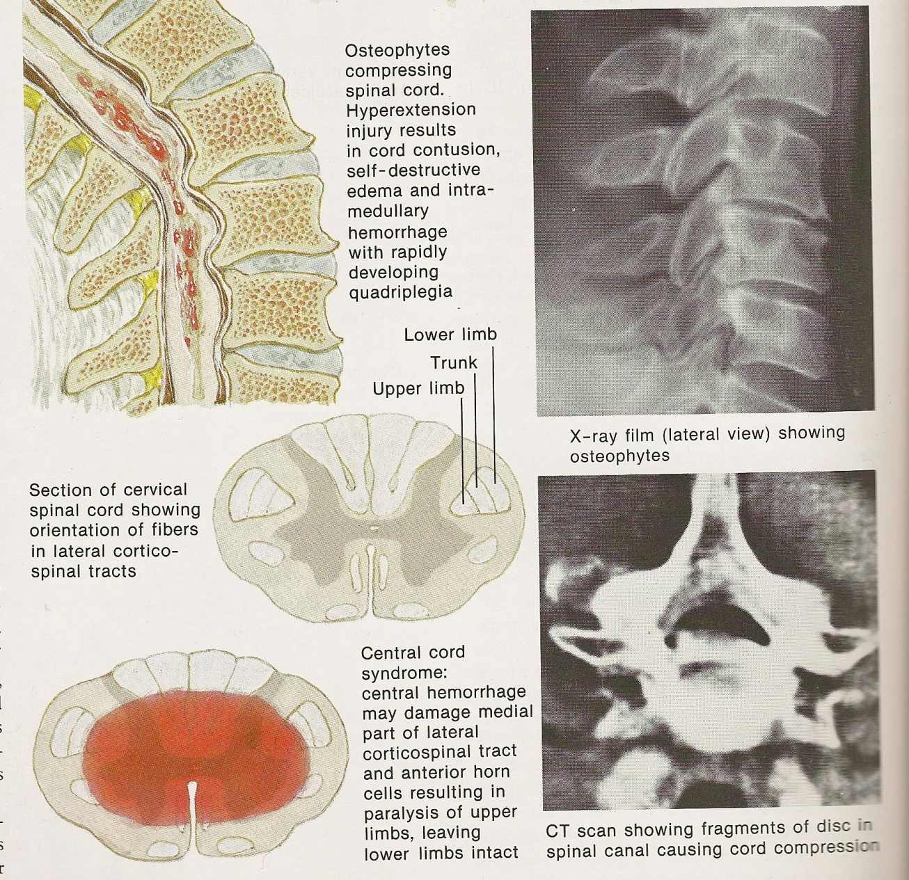
Central Cord Injury

Slide 20
Central Cord Neuropraxia CCN
Transient post-traumatic paralysis of the motor and sensory tracts of the spinal cord
Transient Spinal Cord Injury TSCI
Annual Incidence
17/100,000 High School Football
2.05/100,000 Collegiate Football
Boden, B.P. 2006 Am J Sports Med
Described by Torg in 1986
Mechanism is hyperextension or flexion injury
May be associated with Abnormal Pathology
Cervical Stenosis
Cervical Spondylosis, Disc Herniation
May be associated with Normal Anatomy

Slide 21
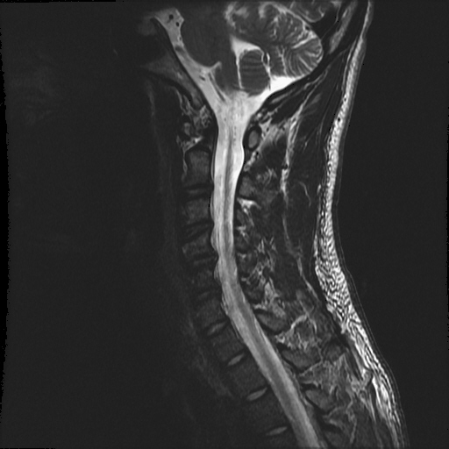
Cervical Stenosis
Congenital
Pavlov Ratio < .8
Prevalence 8-29/100 football players
MRI-Functional reserve
Acquired
Developmental
Compressive
Cervical spondylosis
Cervical Disc Herniation

Slide 22
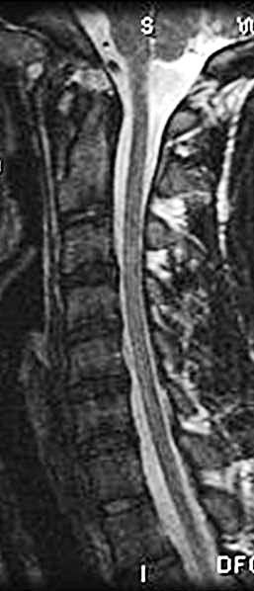
Cervical Stenosis CCN/TSCI
Football player who experienced a TSCI
Complete resolution of symptoms within 24 hrs.
Allowed to return to play after complete resolution of symptoms

Slide 23
TSCI
Abnormal Anatomy
Remove from play
Evaluate
Same
Treatment
Disc herniation
Neurologic ➔ Sx
Non-Neuro➔ ??
Spinal Stenosis
Neuro➔ Sx
Non-Neuro➔??
Return to Play
???????????
Normal Anatomy
Remove from contest
Evaluate
Xray/Dynamic Xray
MRI
Dynamic MRI
Return to Play
Symptoms resolve
Single episode
Imaging normal
Adequate Functional Reserve

Slide 24
Return to Play Guidelines
Recognize Injury
Neurologic/Non-Neuro
Symptoms/signs resolved
Anatomy
Resolve pathology
Stability of Cervical Spine
Adjacent Levels
Athletes future in particular sport
Multiple opinions

Slide 25
Cervical Disc Replacement
Lower incidence of adjacent level disease
Made for athletes
Return to play faster

Slide 26





Slide 27

Conclusions
Minor Cervical injuries are common and usually self limited.
Major Cervical Injuries are rare but can be catastrophic
Recognition of Peripheral vs. Central injury is critical.
Return to play

